Slide 1



Limitation mutualism
Verbal intelligence +1
Startle response
Verbal intelligence
Verbal intelligence
Memory
Creativity
$$θ_{i}$$
$$θ_{j}$$
$$θ_{i}$$
$$θ_{j}$$
$$θ_{i}$$
$$θ_{j}$$
$$θ_{j}$$

Slide 2

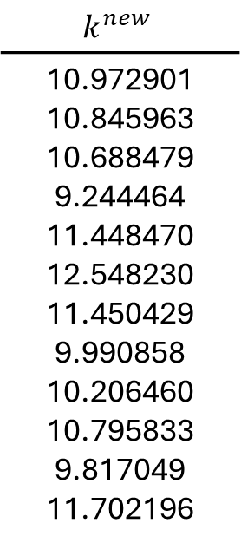



$$p_{i}^{new}=I_{i}p_{i}+(1−I_{i})(A_{i1}\frac{p_{i}+p_{j}+p_{k}+p_{l}}{4}+A_{i2}\frac{\sum_{i}^{N}{p_{i}}}{12})$$
$$p_{i}^{new}=\frac{38}{80}p_{i}+\frac{6}{80}p_{j}+\frac{6}{80}p_{k}+\frac{6}{80}p_{l}+\frac{3}{80}p_{m}+\frac{3}{80}p_{n}+\frac{3}{80}p_{o}+\frac{3}{80}p_{p}+\frac{3}{80}p_{q}+\frac{3}{80}p_{r}+\frac{3}{80}p_{s}+\frac{3}{80}p_{t}$$
$$For I_{i}=\frac{2}{5}, A_{i1}=\frac{1}{4}, A_{i2}=\frac{3}{4}$$
$$k^{new}$$
10.972901 10.845963 10.688479 9.244464 11.448470 12.548230 11.450429 9.990858 10.206460 10.795833 9.817049 11.702196
rnorm(N, 10, 2)
11.471514 11.154167 10.760457 7.150420 12.032110 14.781509 12.037006 8.388079 9.424207 10.897638 8.450678 13.163547
$$θ_{i}$$

Slide 3

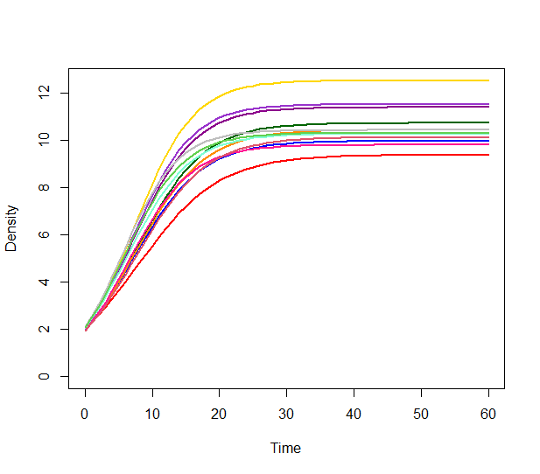
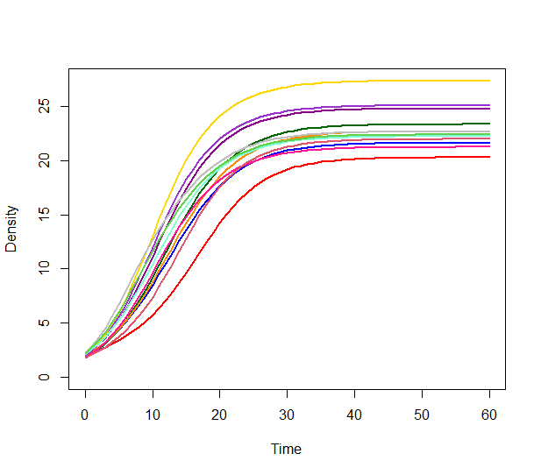
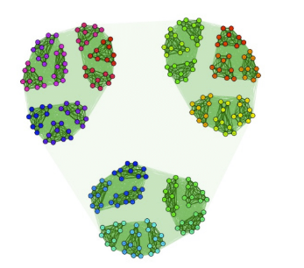
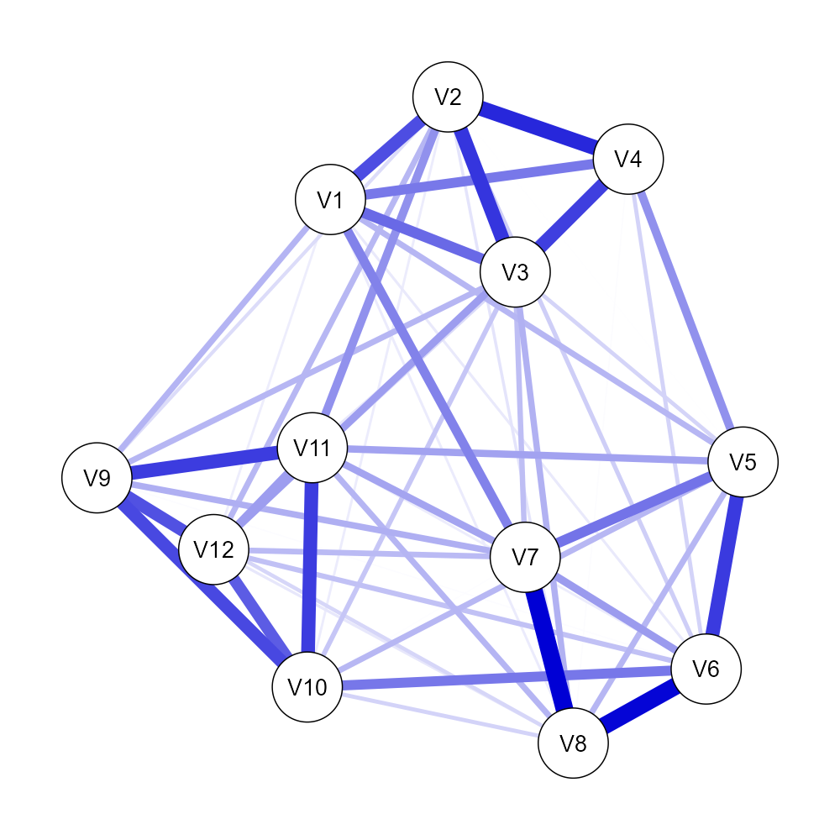
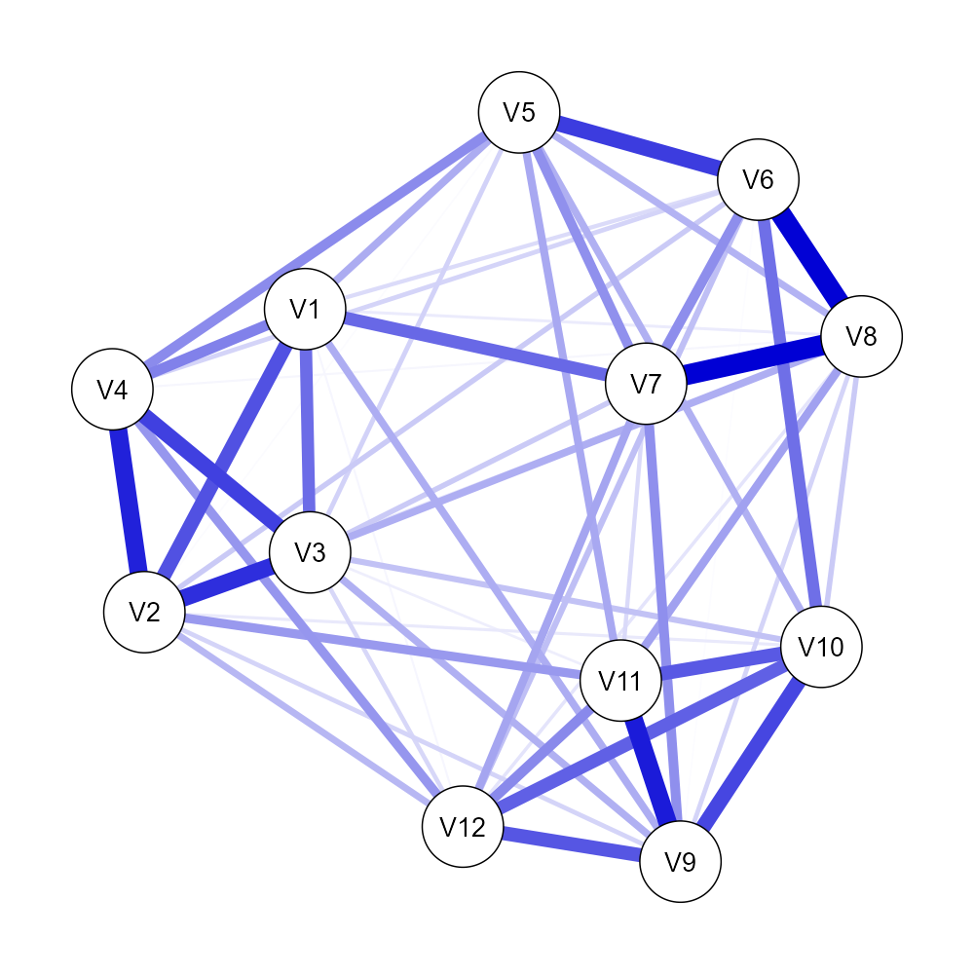
Practical difference

